Slide 1
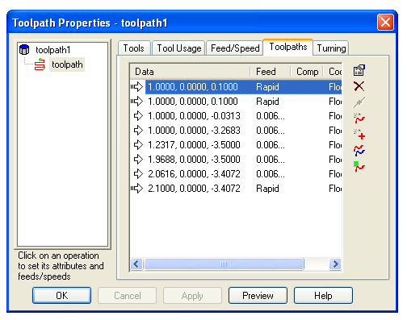
Toolpath Editing
Designed for detailed changes to toolpath
Important for production mill/turn
Sketch a toolpath completely
Modify any move of a toolpath

Slide 2
Toolpath Editing
A new feature type
  From existing operation, or
  From scratch, from a curve
Change point, feed/rapid, coolant, cut comp
  (Use right-click for coolant & cut comp)
Import other curves
Delete a move, split a move

Slide 3
Featurecam Toolpath Editing
How to use Toolpath editing
Why use Toolpath Editing
What to expect in future releases.

Slide 4
Featurecam Face Project
Modify A Face Feature.
Insert points to change the Toolpath.
Insert Rapid Moves

Slide 5
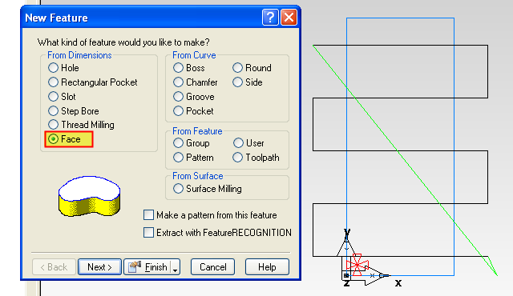
Modify a Face Feature
Start by creating a Face Feature

Slide 6
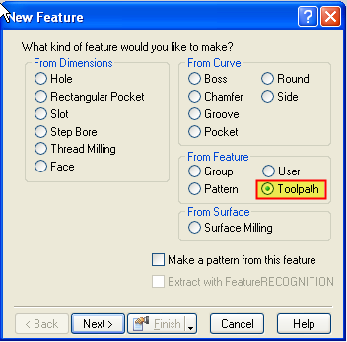
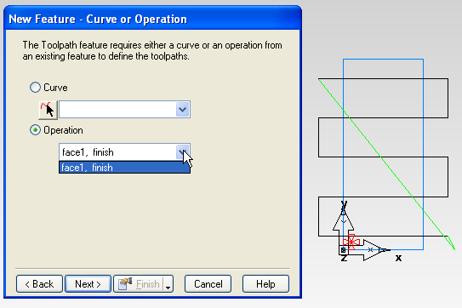
Create New Feature
Create Toolpath Feature and select the operation to modify.

Slide 7
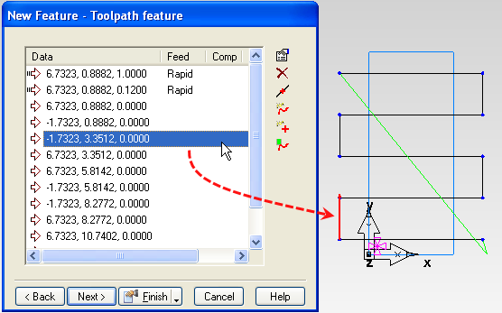
Choose what to edit
Highlight a move to see it turn red on the screen.

Slide 8
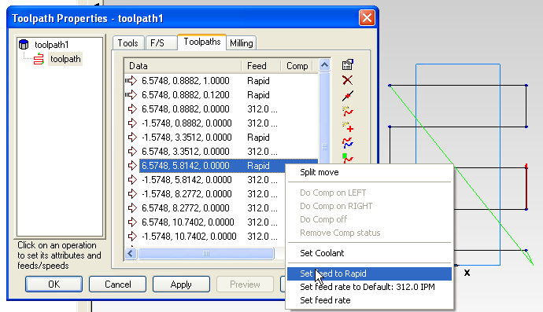
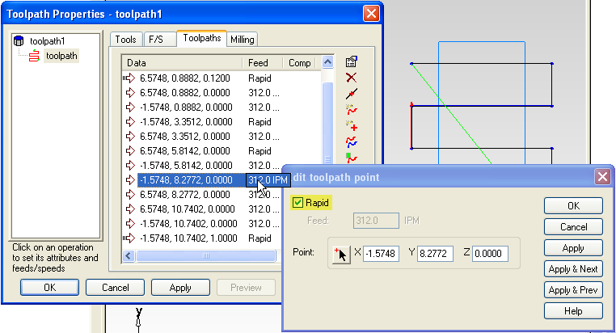
Insert changes easily
Right click will bring up a fly out menu.
Double clicking brings up a Edit Toolpath point window.

Slide 9
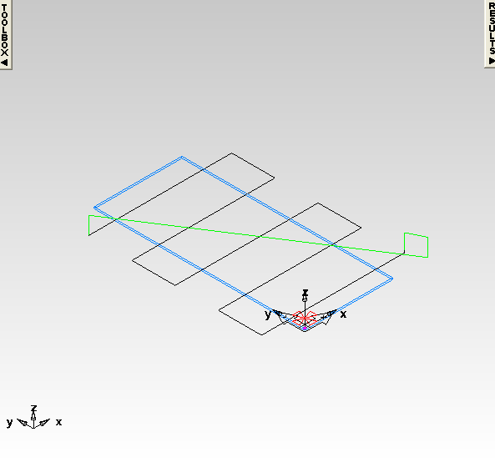
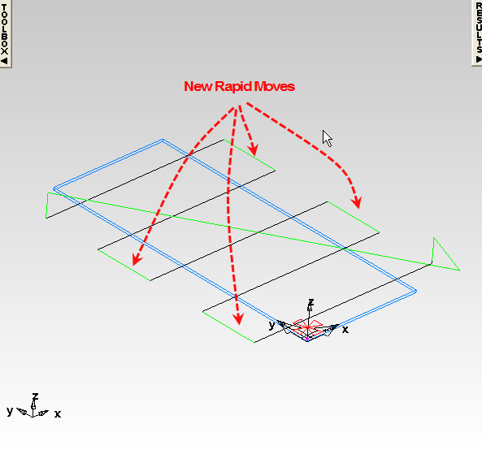
Run centerline Sim
Check your NC code for new moves and Mcodes.

Slide 10
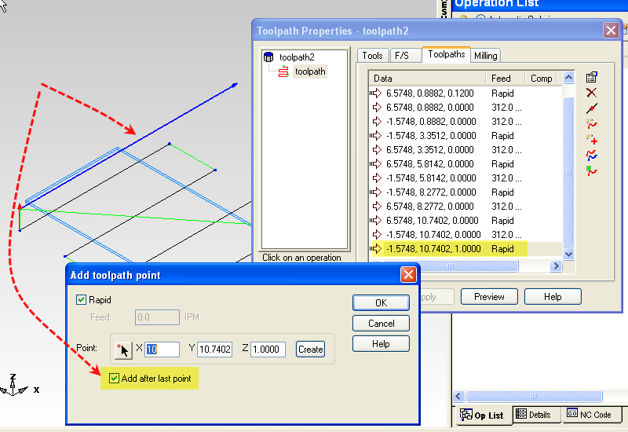
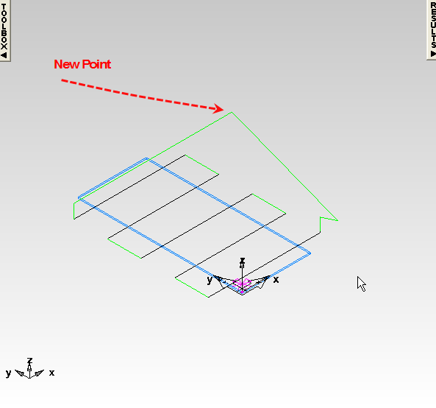
Insert a new Point
Change the rapid move by inserting a new Rapid point.

Slide 11
Featurecam Turn, Finish Toolpath editing Project.
Create Turn Feature.
Export Toolpaths as Geometry.
Add Curve to Replace all Toolpaths.
.
Insert Rapid Moves.

Slide 12
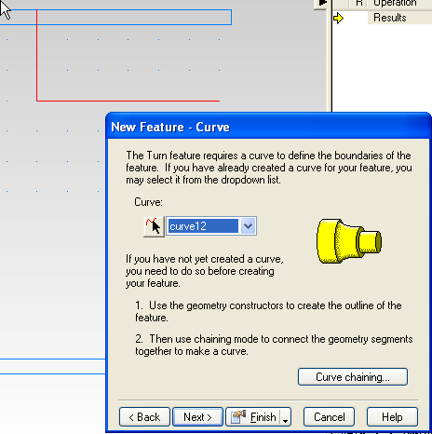
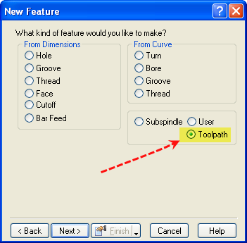
Editing a Simple Turning Job
Create a simple Turn feature.
Then create an Toolpath Feature

Slide 13
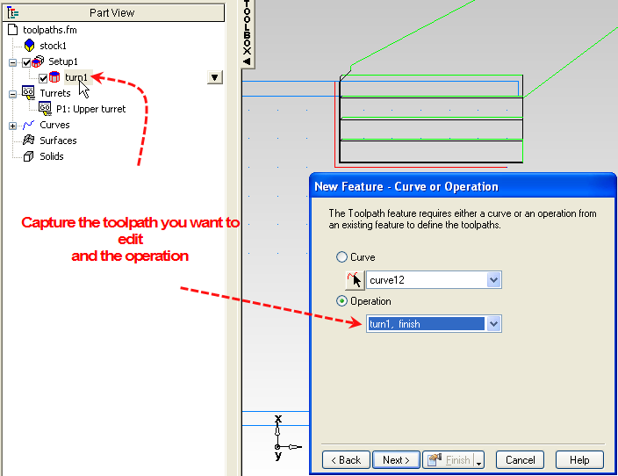
Create the Toolpath Operation
Toolpath Feature requires a curve or an operation

Slide 14
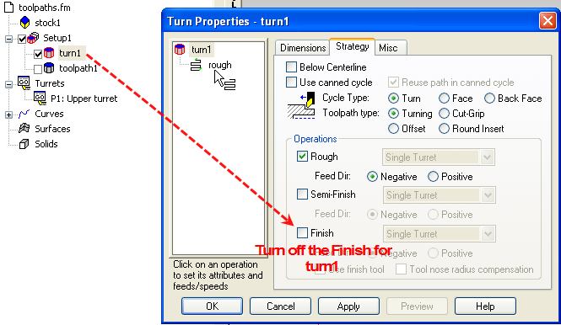
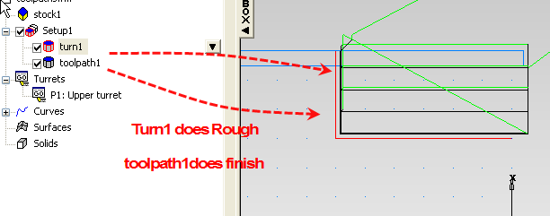
Combining Operations

Slide 15
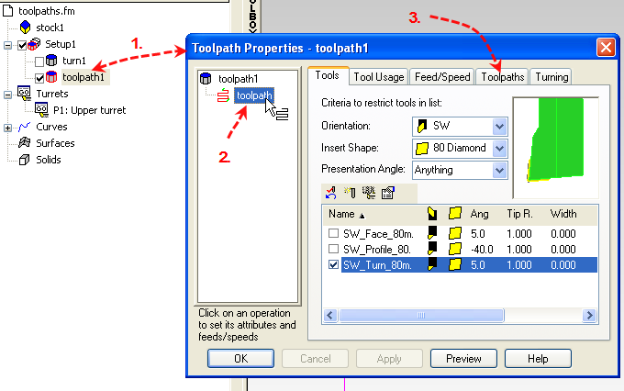
Toolpath Properties page
Double Click Shows a new ToolpathsTab.

Slide 16
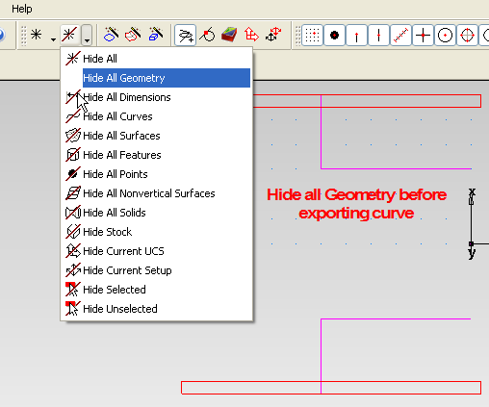
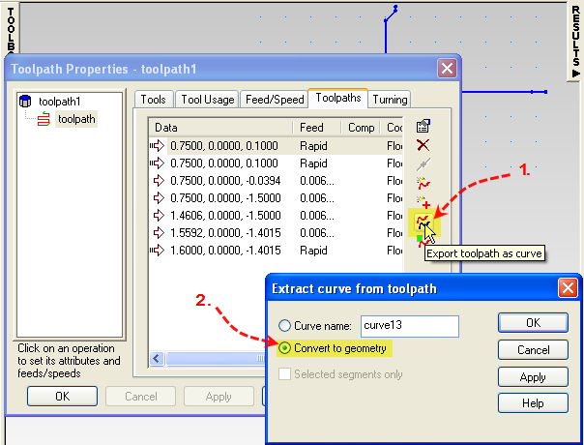
Export Toolpath & Convert to Geometry.
Hide all before converting to geometry

Slide 17
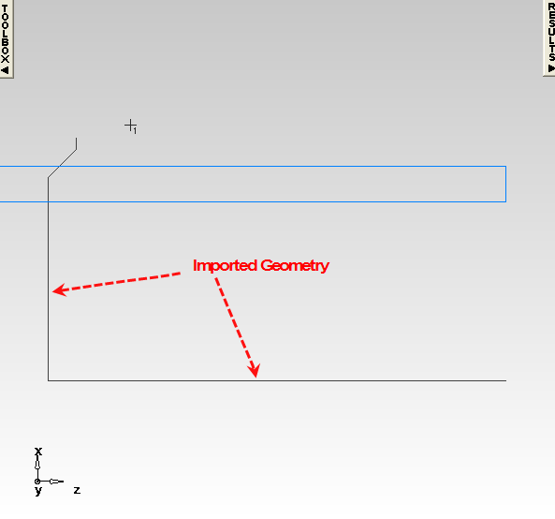
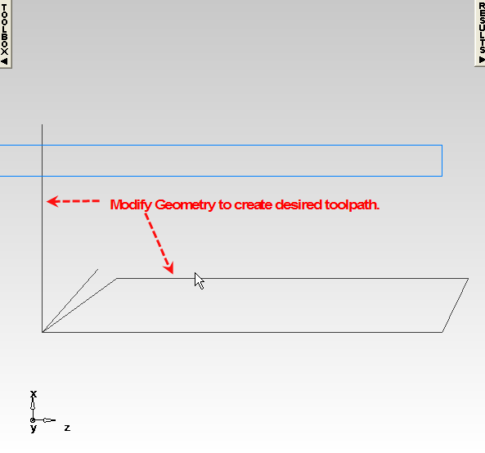
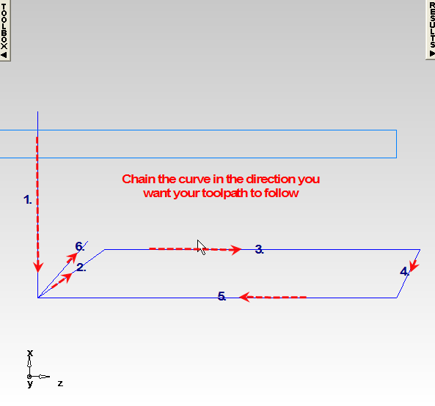
Import, Modify and chain Curve
1.
2.
3.

Slide 18
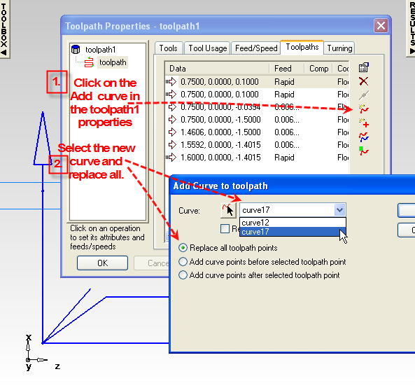
Add the new curve
You can replace all.
You can add the curve Before the toolpath point or After the point.
Note: You may want to reverse the curve.

Slide 19
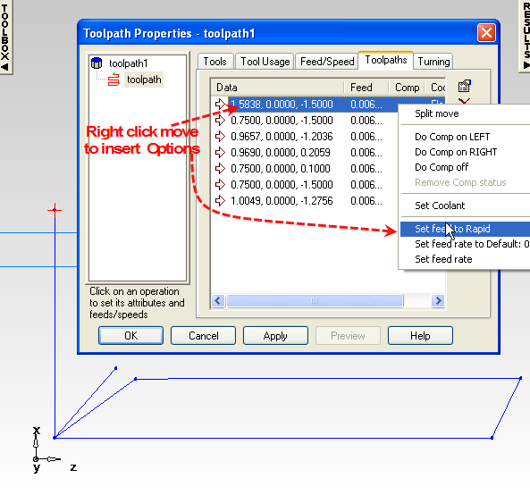
Set your Rapids, Feed Rate, ect…

Slide 20
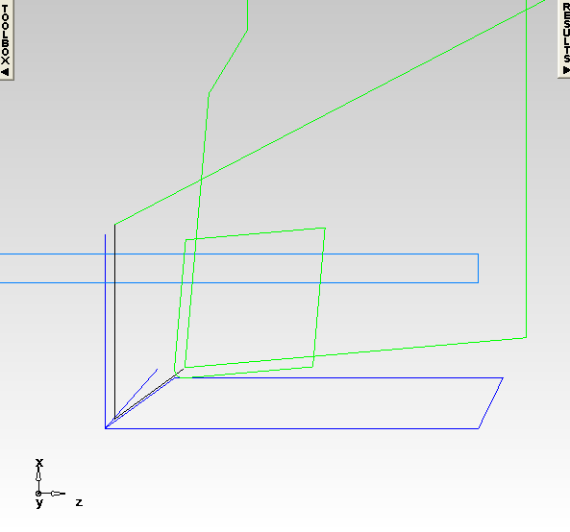
Run your Centerline Sim

Slide 21
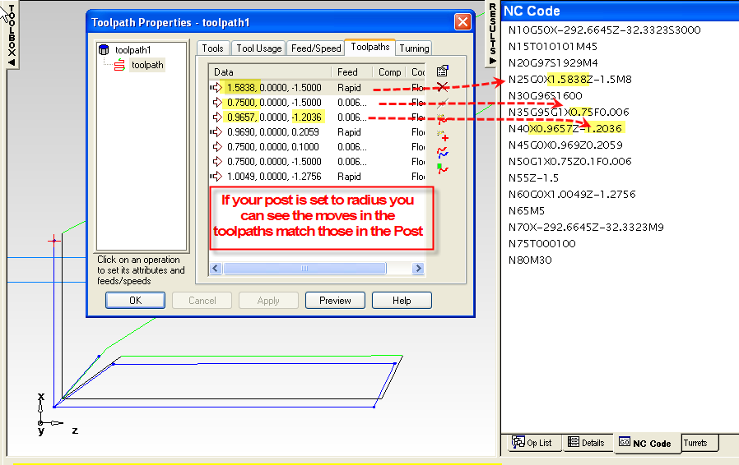
Viewing the Code
Check your code to see if the code matches the Toolpaths Tab.
Note: The settings in your post may reflect different numbers .

